Slide 1


US Cost of Living Analysis Year 2022
, Hiral Lunkad

Slide 2

Inflation & Cost of Living
Inflation rates are rising in the US, which impacts cost of living. This is a popular topic that is discussed on social media and news outlets.
For this I thought out to collect data on the cost of living in different US cities and to identify cost of living trends and to determine which factors impact living costs the most.
The data I collected and analyzed can serve as one resource to help recent graduates to determine what cities they would like to move to if cost of living is a major concern.

Slide 3
Questions:
Descriptive analysis
How expensive are:
States?
Regions?
Cities?
Are food costs a concern?
What is the biggest expense?
What expenses are concerning?
Regression:
What is the relationship between population and:
Rent?
Transportation?
Utilities?
Food?
Population?
What is the relationship between rent and median income?
Clustering
Which cities cost more than average?
Which cities are cheaper?
What cities make up which clusters?
What is the ratio of median income to total cost of living

Slide 4
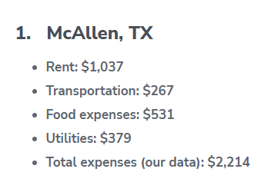
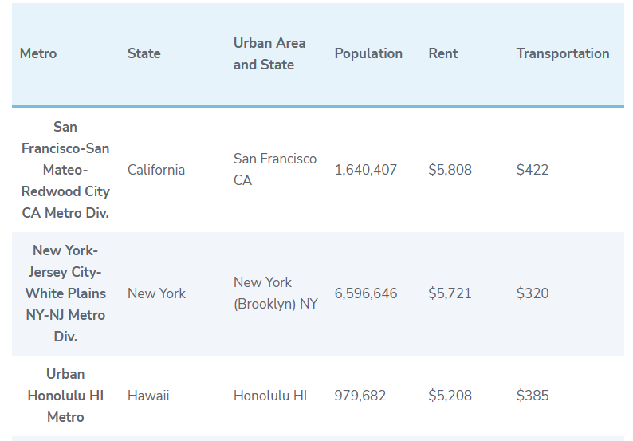
Data Source Website: US Cities with the Lowest Cost of Living | Move.org

Slide 5
SQL Database
Int
Table Name
Cities
Column Names
Name
State
City
Region
Population
Rent
Transportation
Food
Utilities
Total_expenses_web_data
Total_expenses_coli
Median_income
Data types
Varchar
Varchar
Varchar
Varchar
Int
Int
Int
Int
Int
Int
Int

Slide 6
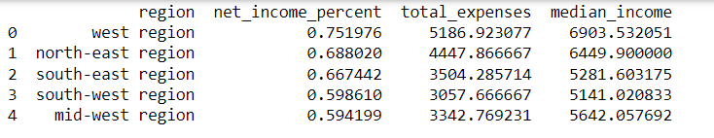
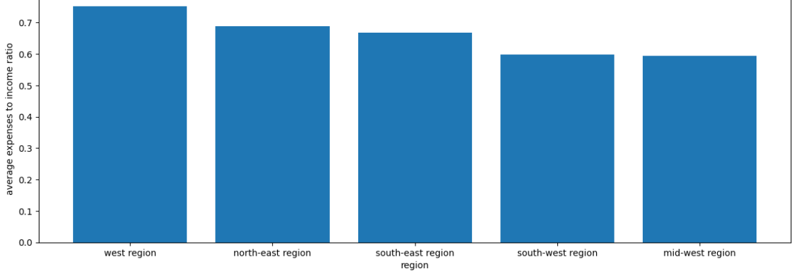
Descriptive Analysis: Net Income by Region
MAIN FINDINGS
West and North-East regions are the least affordable
However, none of the regions are unaffordable.
Net median income is %24.9 - %40.6

Slide 7
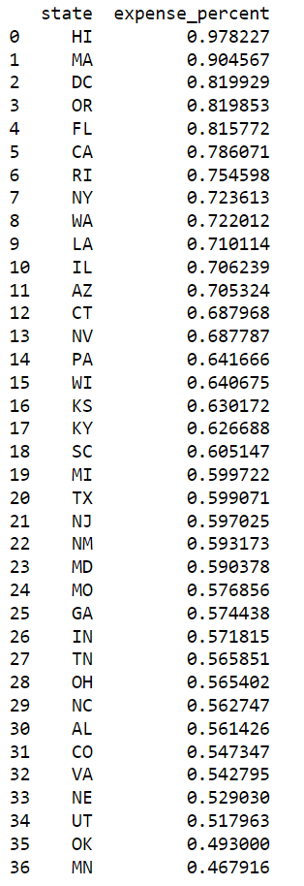
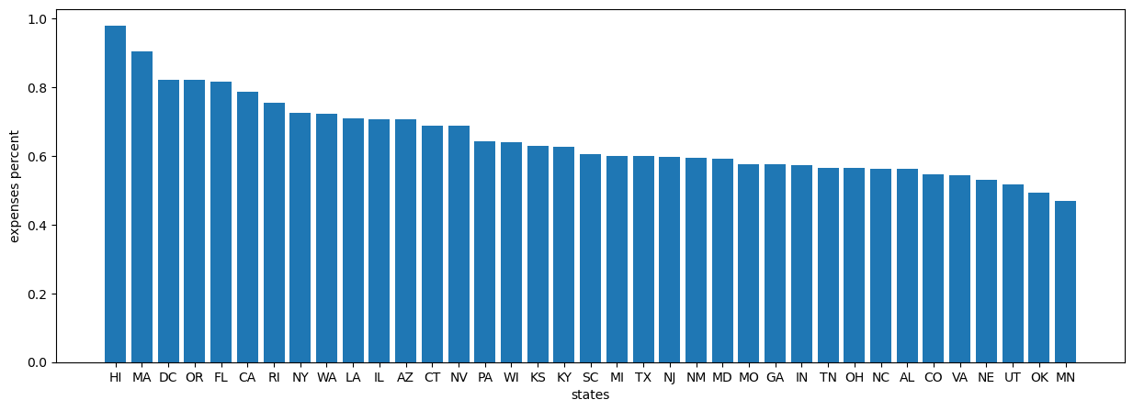
Descriptive Analysis: Net Income by State
MAIN FINDINGS
State level data exposes a much larger difference:
51% difference in net median income
Hawaii and Massachusetts keep less than 10% of median income
Minnesota and Oklahoma take home the majority of median income

Slide 8
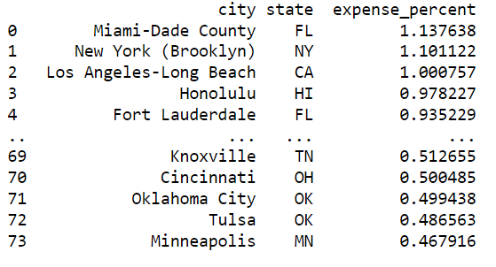
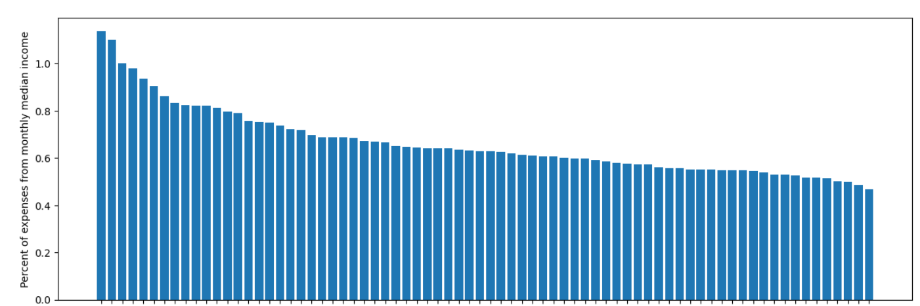
Descriptive Analysis: Net Income by City
MAIN FINDINGS
At the city level we see the full range of affordability:
A difference of 67% of the net median income
Miami, NYC, and LA all have expenses that total to more than the local median income
Oklahoma city, Tulsa, and Minneapolis still have half their gross median income.

Slide 9
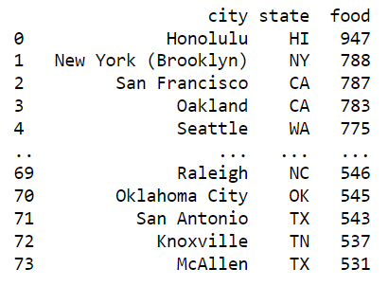
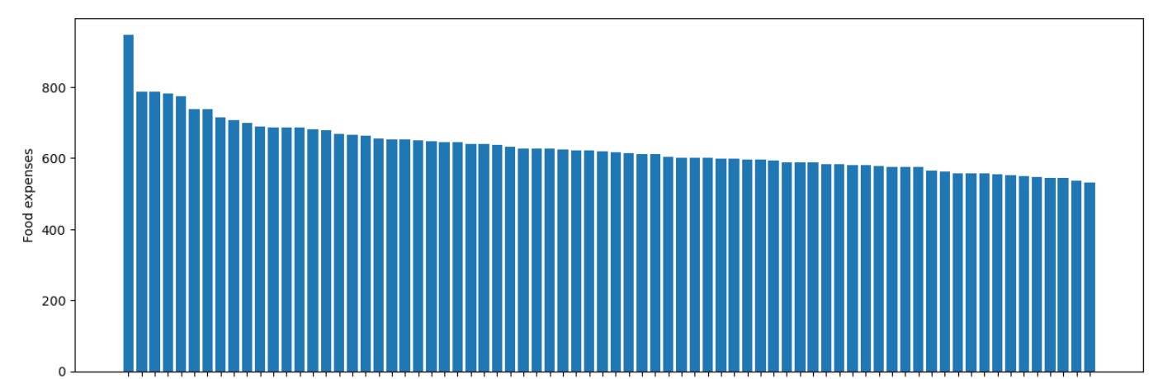
Descriptive Analysis: Food Expenses
MAIN FINDINGS
Food is not expensive
Honolulu is an outlier
Small difference of $257 between NYC and McAllen, TX
Except for big families, food expenses are not a concern

Slide 10
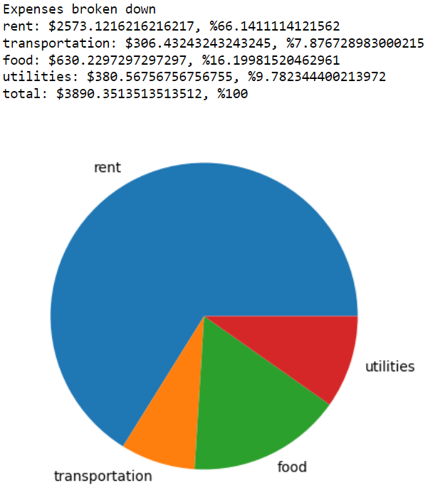
Descriptive Analysis: Total Expenses Breakdown
MAIN FINDINGS
Rent is by far the largest expense
66% of total expenses
Food is the second largest expense
Less than $750
Only 16% of total expenses

Slide 11
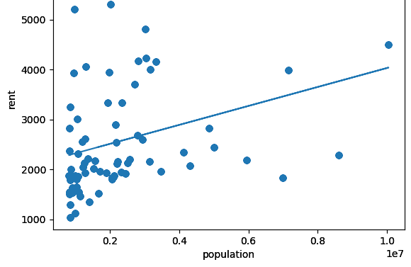
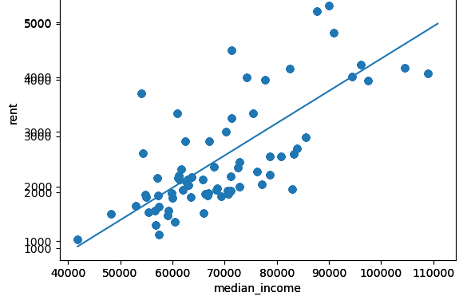
Linear Regression Analysis: Rent Associations
MAIN FINDINGS
Rent against Population
Does population size or median income have a stronger association with rent costs?
54% of the changes in rent costs are accounted for by the changes in median income.
10% of the changes in rent costs are accounted for by the changes in population size.
Median income has a stronger positive association with rent costs in comparison to population size.
(R2) = .10220
Rent against Median Income
(R2) = .53618

Slide 12
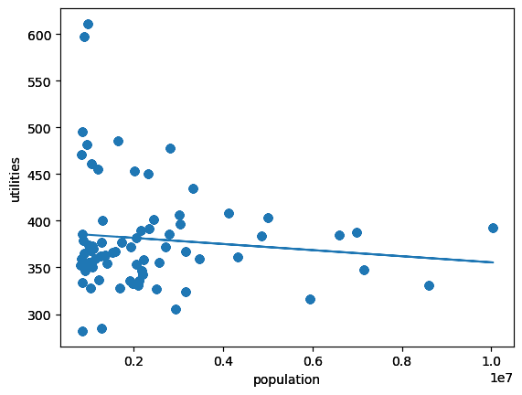
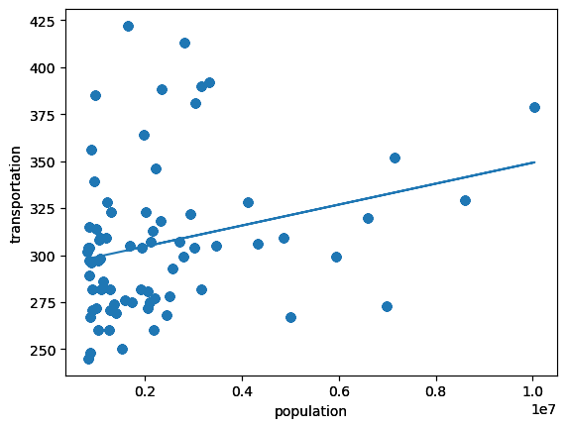
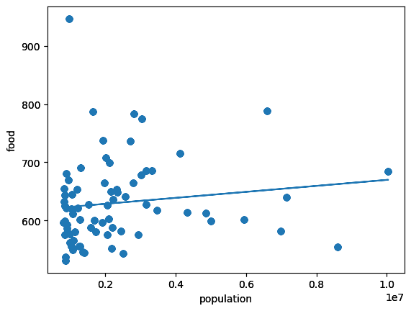
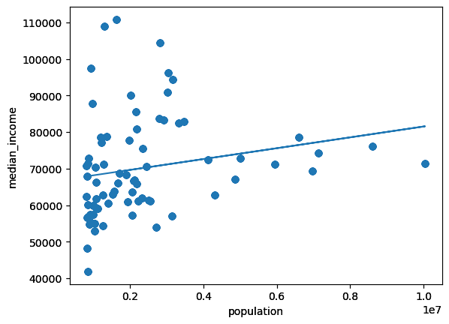
Linear Regression Analysis: Population Size Associations
Utilities against Population
Transportation against Population
MAIN FINDINGS
Does population size have a strong association with the cost of utilities, transportation, food and/or median income earned?
All the models have a r-square value that is less than 1% which indicates that less than 1% of the changes in the variables are accounted for by the changes in the population size.
Utilities (R2): .01107
Transportation (R2): .06977
Food (R2): .01807
Median Income (R2): .04058
A city's population size has zero association to the cost utilities, transportation, food and median income.
Food against Population
Median Income against Population

Slide 13
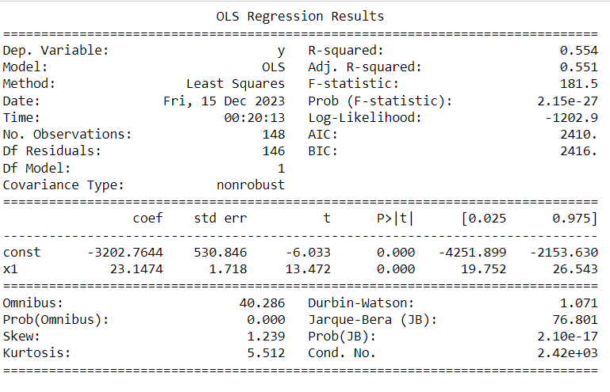
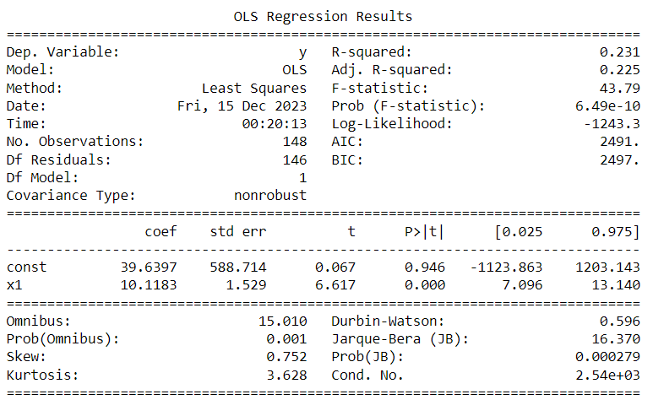
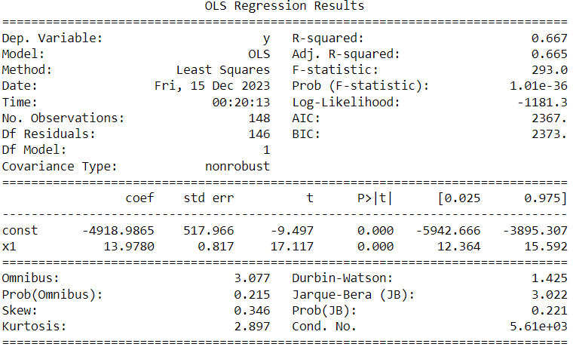
Regression Analysis
The first figure shows the estimated effects of the independent variable 'food' on the dependent variable 'total_income_web_data'.
The second figure shows the estimated effects of the independent variable 'transportation' on the dependent variable 'total_income_web_data'.
The third figure shows the estimated effects of the independent variable 'utilities' on the dependent variable 'total_income_web_data'.

Slide 14
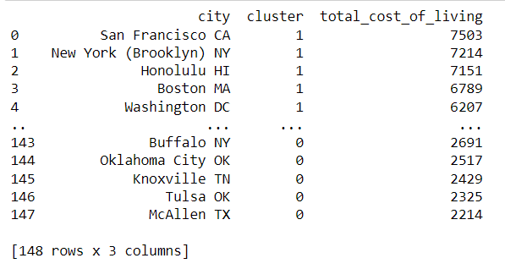
Cluster Analysis
Most expensive and least expensive cities to live in the United States
Cities assigned to Cluster 1 are characterized by having a higher total cost of living compared to other cities in the dataset. These cities share commonalities in terms of higher expenses for rent, transportation, food, and utilities.
Cities assigned to Cluster 0 are characterized by having a lower total cost of living compared to other cities in the dataset. These cities share commonalities in terms of lower expenses for rent, transportation, food, and utilities.

Slide 15
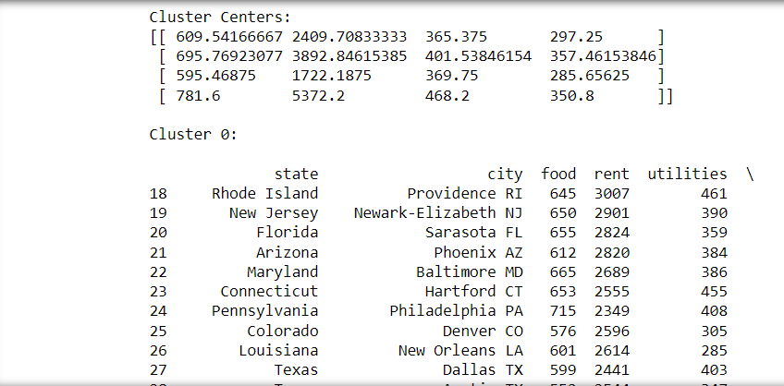
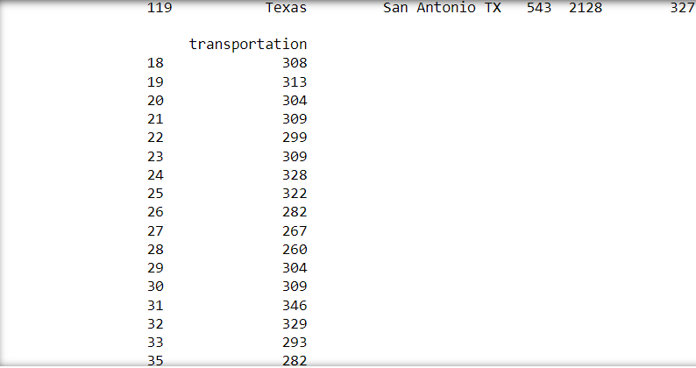
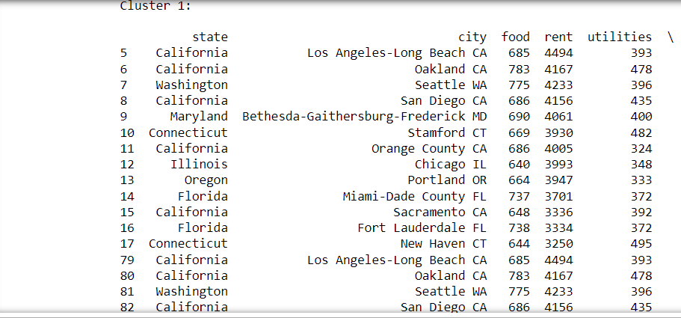
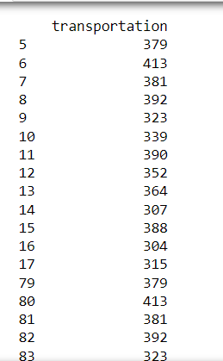
Cluster states and cities based on their overall cost of living index. This would allow us to identify groups of states and cities with similar costs of living. The cluster centers represent the average values of food, rent, utilities, and transportation within each cluster. These are the points around which the data points in each cluster tend to gather. By inspecting the printed information for each cluster, you can identify which states and cities belong to each cluster and observe the characteristics values of food, rent, utilities and transportation in those clusters.
Cluster Analysis

Slide 16
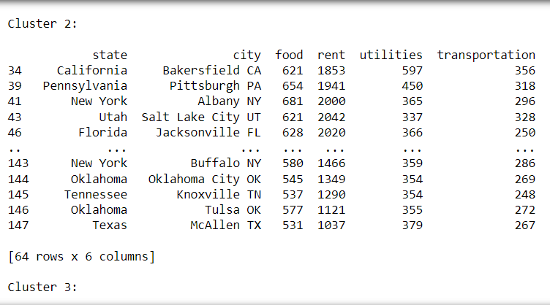
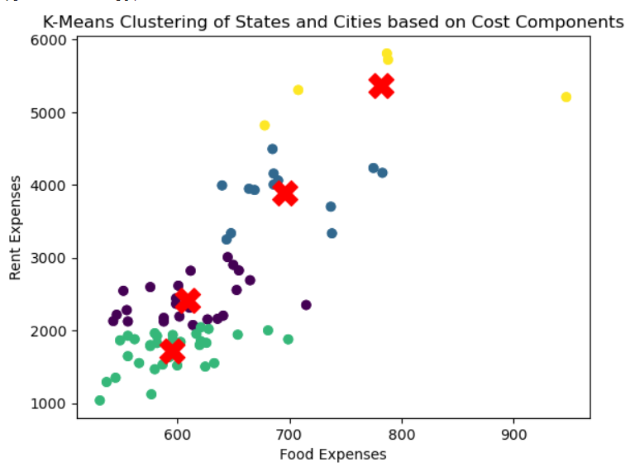
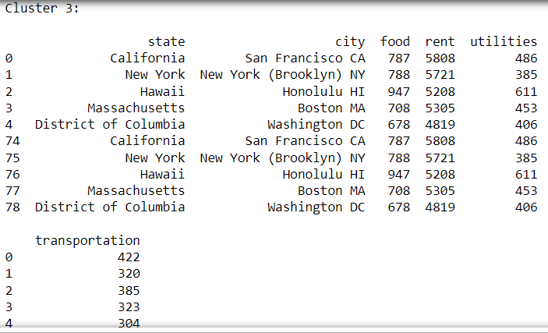
Cluster Analysis
The scatter plot provides a visual representation of how the states and cities are grouped based on food and rent. Data points with similar cost components are grouped, and the cluster centers indicate each cluster's central tendencies.

Slide 17
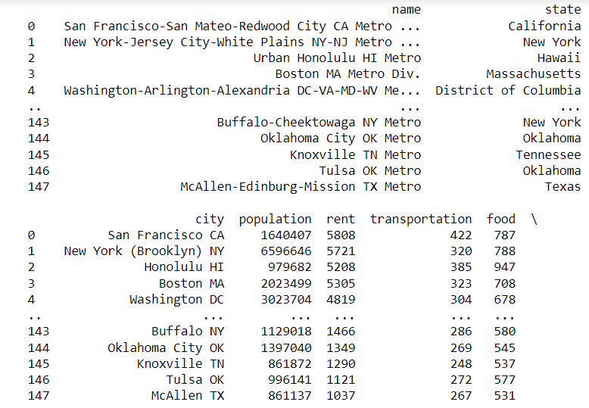
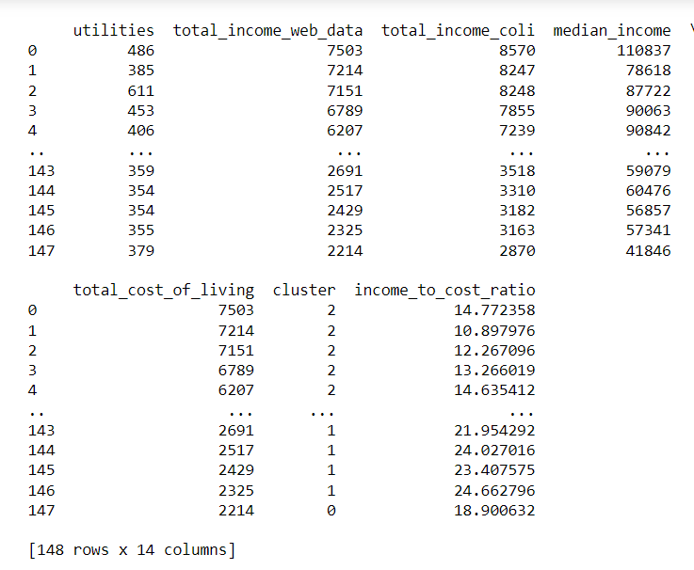
Cluster Analysis
To know the ratio of median income to total cost of living (including food, utilities, rent, and transportation).
The code calculates two new columns for each city in the dataset: total_cost_of_living: The sum of 'food', 'utilities', 'rent', and 'transportation', representing the total cost of living and income_to_cost_ratio: The ratio of 'median_income' to 'total_cost_of_living', providing an indicator of how median income compares to the cost of living.
The number of clusters is set to 3, that will group cities into three clusters based on their income-to-cost ratios. Each city is assigned a cluster label based on the K-means clustering results.
The final result includes the original information about cities, along within the calculated 'total_cost_of_living', 'income_to_cost_ratio', and the assigned 'cluster' label.

Slide 18

Summary
My main findings are not in alignment with common narratives about cost of living in the US:
Common Narrative: West and North-East cities are not affordable.
My findings: West and North-East regions are the least affordable, however they are not statistically unaffordable.
Common Narrative: Income is stagnant and rent costs are rising.
My findings: Median income has a positive association with rent costs.
Common Narrative: The bigger the city, the more expensive it will be.
My findings: Population size does not have a strong positive association with the cost of living.

Slide 19

Technical Achievements
Scraping the website.
Inputting the data into the database.
Formatting the coefficient and R-square output to be readable.
Creating and analyzing the visualizations.

Slide 20
Thank you!

